Slide 1
Influenza cellular binding avidity change: beneficial or deleterious effects on epidemic dynamics?
Hsiang-yu Yuan
James Hay

Slide 2
figure1: Netcharge is a good marker of binding avidity
Notes:
E:\Documents\Github\BindingAnal\validate_netcharge\plot_bindingchanges.R

Slide 3
figureS1
Notes:
E:\Documents\Github\BindingAnal\validate_netcharge\plot_bindingchanges_abs_reg.R

Slide 4
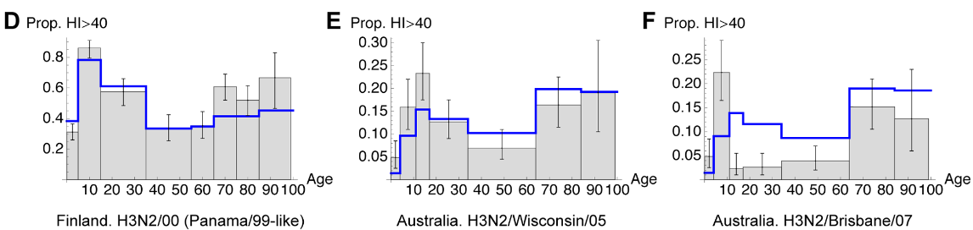
figure2: Net charge and seroprevalence show similar distribution
AJ Kucharski ‎2012 Plos CompBio
Notes:
E:\Documents\Github\BindingAnal\validate_netcharge\netcharge_age19.R

Slide 5
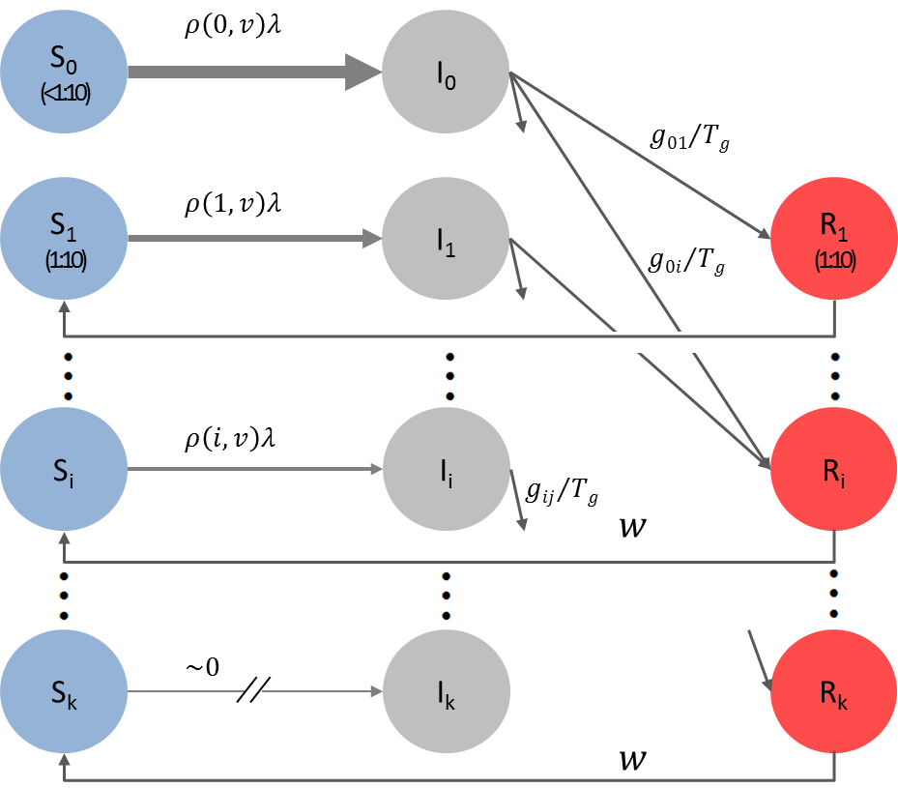
figureS5: We constructed a model to study the Effect of Binding Avidity Adaptation
Notes:
A. ?
B. E:\Documents\Github\BindingAnal\fitness\tradeoff\Mtradeoff\plot_Rin_infection.m
C. E:\Documents\Github\BindingAnal\fitness\tradeoff\Mtradeoff\plot_prob_infection.m

Slide 6
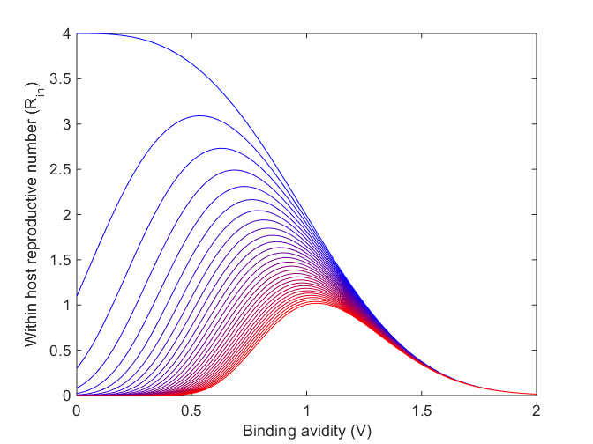
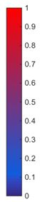
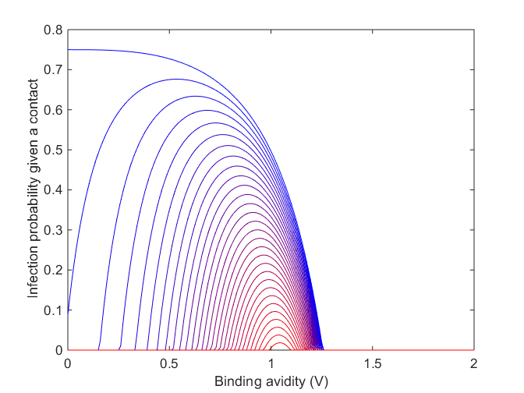
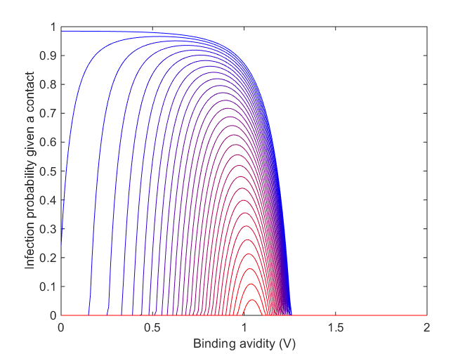
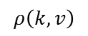
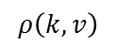
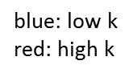
figure3: Within host fitness and Probability of Infection
$$ρ\left(k,v\right)$$
$$ρ\left(k,v\right)$$
blue: low k
red: high k
Notes:
where is the alternative fitness profile (without differential selection)?

Slide 7
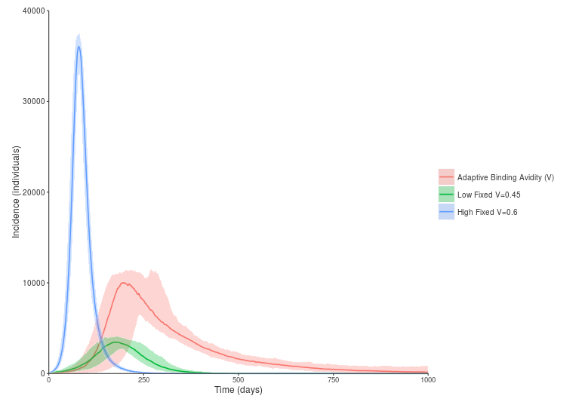
figure4: Simulated Epidemics from the IBM
epidemic dynamics
immunological dynamics
Notes:
The figure is produced from IBM (The script James wrote)
workdir E:\Documents\Github\BindingAnal\fitness\tradeoff\Mtradeoff\dat\lowV0
workdir E:\Documents\Github\BindingAnal\fitness\tradeoff\Mtradeoff\dat\highV0
Low fixed V=0.45
Hight Fixed V=0.6
Adaptive binding V0=0.45
D = 200day

Slide 8
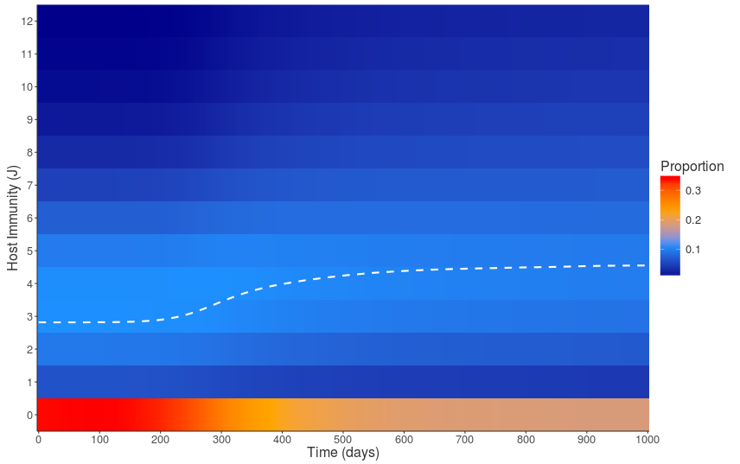
figure5: Simulated Immunologic dynamics from the IBM

Slide 9
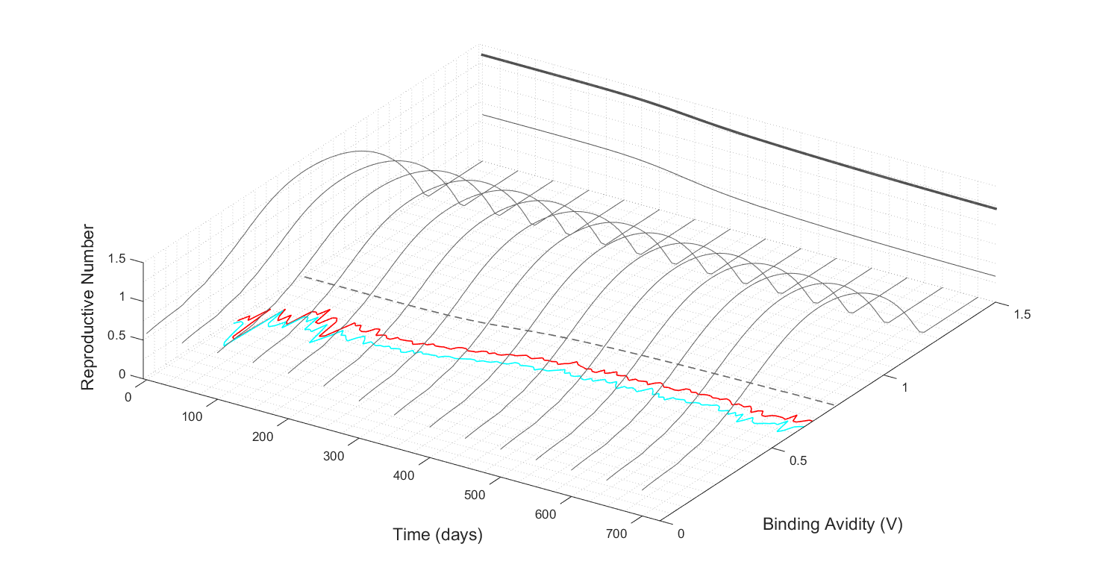
figure6: The Short-sight Evolution of Binding Avidity Adaptation
Notes:
Dashed: Optimum binding avidity
Red: Initial binding avidity
Cyan: Final binding avidity
workdir E:\Documents\Github\BindingAnal\fitness\tradeoff\Mtradeoff
example:
infileV = 'dat/lowV0/voutput1_low_adaptive.csv';
infile = 'dat/lowV0/hostKs_low_adaptive.csv'
plotPopRfromSkwithBinding(infile, infileV)
E:\Documents\Github\BindingAnal\fitness\tradeoff\Mtradeoff\dat\lowV0\virusbinding.mat, which contains:
Vfinal, Vini and Vopt. But I am not sure what this data is for?

Slide 10
figure7: Relative fitness
Notes:
E:\Documents\Github\BindingAnal\fitness\tradeoff\Mtradeoff\figs\fitness

Slide 11
figureS2: Adaptation of Adsorption mutations can be explained by Mutation-Selection Balance phenomenon
Notes:
To be changed: Make it as 3d surface
workdir: E:\Documents\Github\BindingAnal\fitness\tradeoff\Mtradeoff
infile = 'dat/lowV0/hostKs_low_adaptive.csv‘
infileV = ??
plotMutSelBalance(infile)

Slide 12
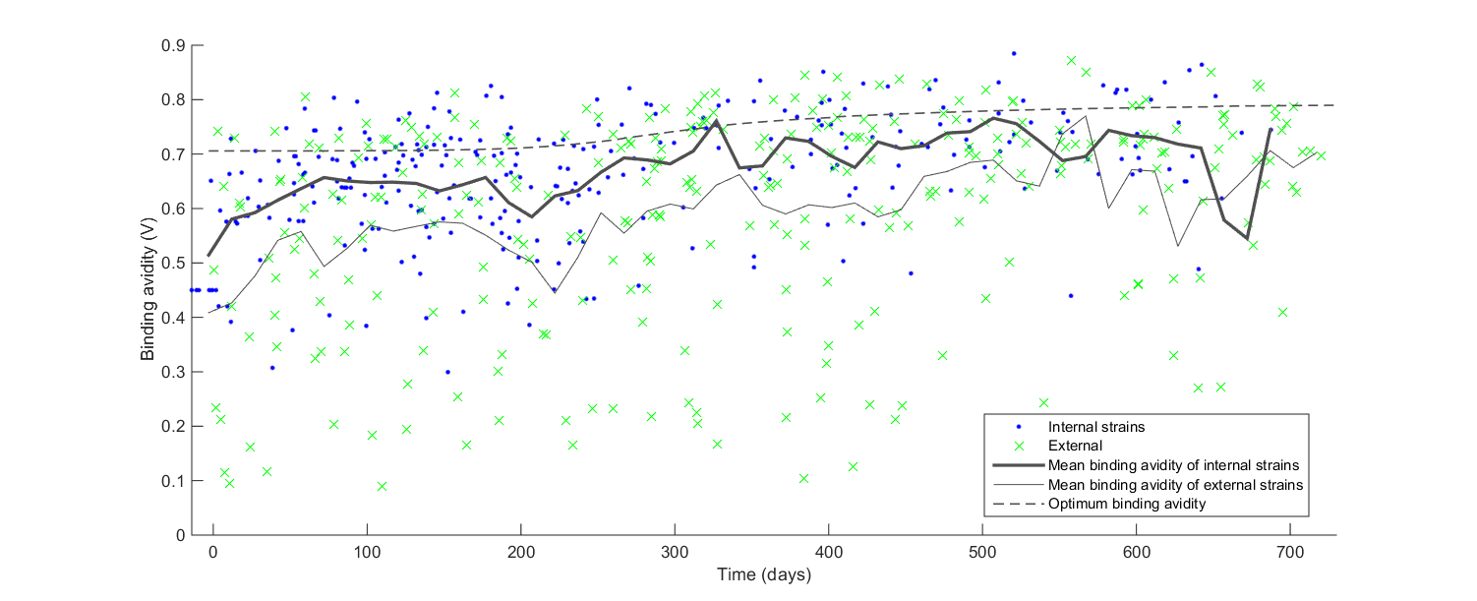
figure8: The Deleterious Effect of Binding Avidity Adaptation on viral phylogeny
Notes:
Change it to simulated binding avidity.
How to generate simple.mat?? (check These steps work for real viral sequences.docx)
workdir: E:\Documents\Github\BindingAnal\ParseTree\mat\Mparsetree
plotNetchargeByTimeSim(infile, infileB)
infile = ‘dat/lowV0/voutput1_low_adaptive_tree_300_simple.mat’
infileB = ‘dat/lowV0/virusbinding_low_adaptive.mat’

Slide 13
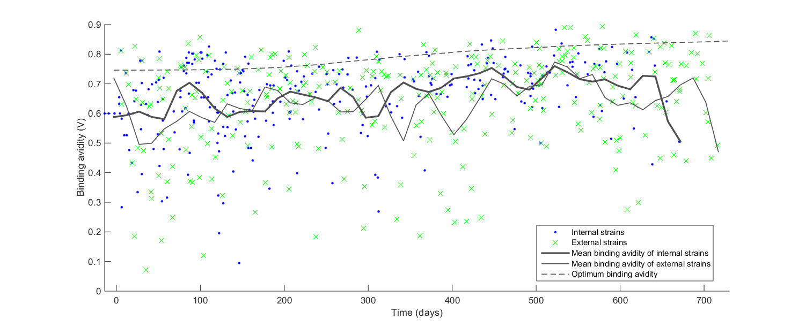
figureS3: The Deleterious Effect of Binding Avidity Adaptation on viral phylogeny
Notes:
voutput1_low_adaptive_tree_300_simple.png
workdir: E:\Documents\Github\BindingAnal\ParseTree\mat\Mparsetree
plotNetchargeByTimeSim(infile, infileB)
infile = ‘dat/highVirus/voutput1_highv_tree_300_simple.mat’
infileB = ‘dat/highVirus/virusbinding.mat’

Slide 14
Figure8: Phylogenetic Analysis using viral sequence data
For all internal nodes, only 7.7% of the strains showed netcharge change
whereas in external tips, which were destined to die out soon, a higher proportion of the strains (11.8%) changed the netcharge
Notes:
Studies showed that higher ratios of non-synonymous-to-synonymous substitutions on external tree branches relative to those found internally (http://dx.doi.org/10.1093/molbev/msm001).
workdir: E:\Documents\Github\BindingAnal\ParseTree\mat\Mparsetree
1. To compare the variance between internal and external nodes
[netcharge ] = calNetCharge( )
internal vs external
proportion of netcharge change (7.8% vs 12.1%)
the variance (1.13 vs 1.18)
netcharge prevalence(>18) (20.0% vs 18.7%)
2. To find out the
which code produce this hm_h3n2_ny_charge_1993_2006.mat and newick_elements.mat?
hm_h3n2_ny_charge_1993_2006.mat is not consistent to my tree file

Slide 15
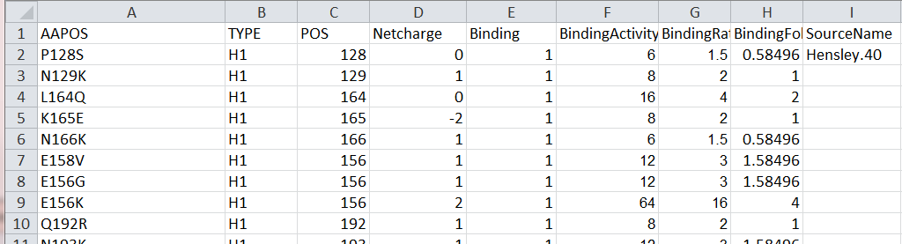
table1. validate_netcharge.csv

Slide 16
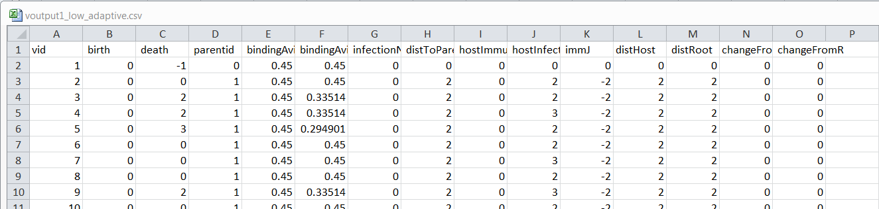
Notes:
Input files produced from IBM (output from IBM code James wrote)
infileV = 'E:\Documents\Github\BindingAnal\fitness\tradeoff\Mtradeoff\dat\lowV0\voutput1_low_adaptive.csv';
infile = 'E:\Documents\Github\BindingAnal\fitness\tradeoff\Mtradeoff\dat\lowV0\hostKs_low_adaptive.csv‘
Data are used by “figure7: The Short-sight Evolution of Binding Avidity Adaptation”

Slide 17
main_generate_tree('dat/mod01/voutput_small', '50', '10', '200')

